Slide 1

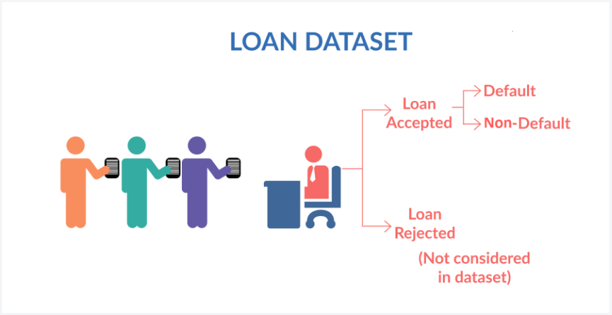
Lending Club Case Study
Group Members:
Shailender Tomer
Utkarsh Tyagi

Slide 2
Abstract ● Lending club is the largest online loan marketplace, facilitating personal loans, business loans, and financing of medical procedures. ● Borrowers can easily access lower interest rate loans through a fast online interface.
Business Objective
The objective of analysis is to use the information about past loan applicants and find whether they ‘defaulted’ or not.

Slide 3
Problem solving methodology
Data Cleaning
Univariate analysis
Bivariate analysis
Recommendations
Data understanding

Slide 4
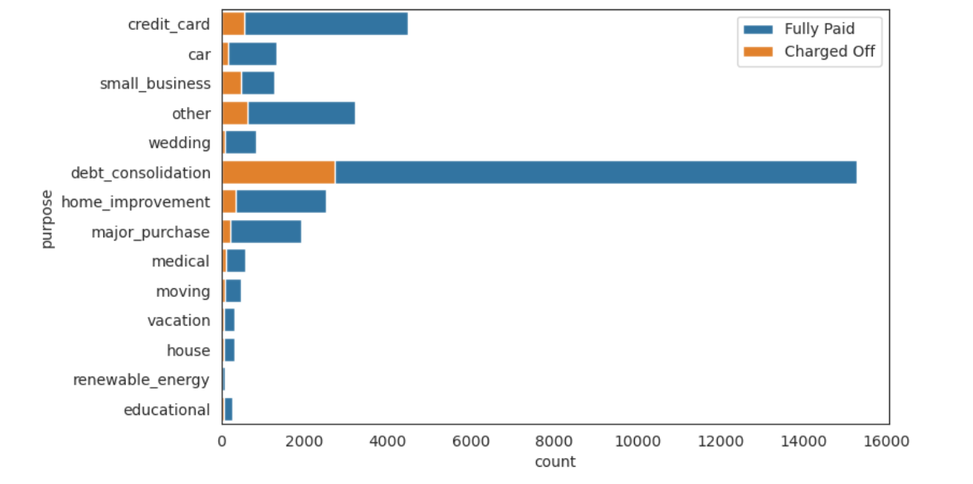
Analysis
Large scale businesses are the highest revenue generators by far even though the percentage of charged off amount might be the same.
These clients should be given priority when making loan products available

Slide 5
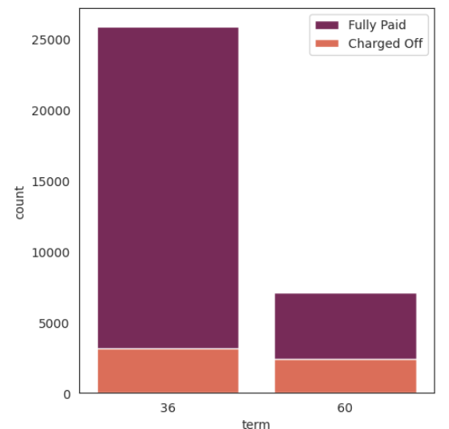
Analysis
The default rate is high in 60 months tenure because most people took high loan amount with high interest rate in it and they faced difficulties in returning the sum to bank.

Slide 6
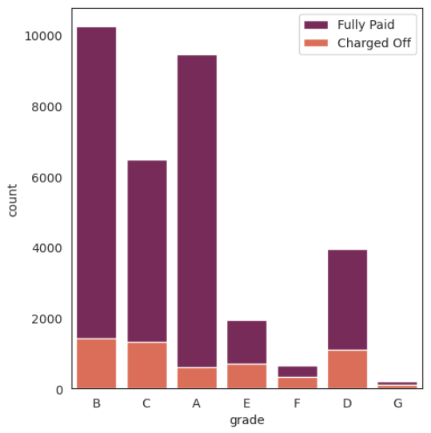
Analysis
The grades of loan have a direct impact on the recovery .
The higher grade loans have a significantly more recovery ratio than lower graded loans
The quality of grades as represented by the graphs is A > B > C

Slide 7
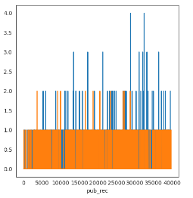
Analysis
The customers with high number of derogatory public records have a significantly higher chance of defaulting on there repayments .
Banks should avoid lending to these customers

Slide 8
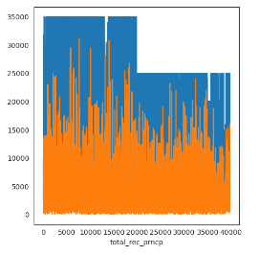
Analysis
Customers with salaries higher than 15000 are significantly better at repaying the principal amount then the rest.

Slide 9
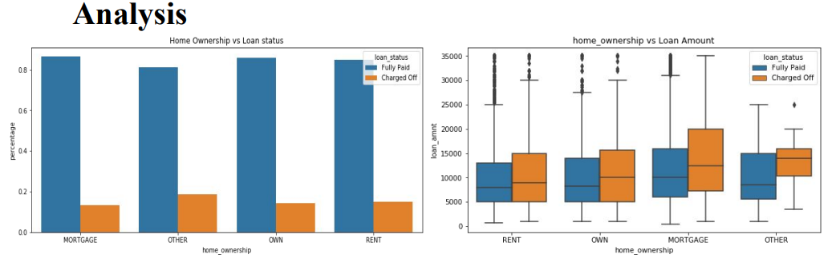
There is around 20% chance of loan default in each home ownership category.
From the 2nd plot we can see the people with higher loan amounts in mortgage home ownership has high default rate than others.

Slide 10
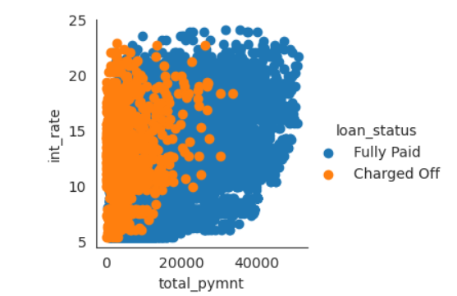
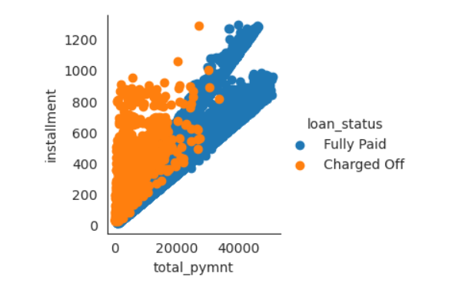
Analysis
* If installment is more as per loan payment, customer has more chances for default
* If interest rate is more as per total loan payment, customer has more chances for default

Slide 11
Conclusion
Large scale businesses are the highest revenue generators by far even though percentage of charged off amount might be same.
The default rate is high in 60 months tenure because most people took high loan amount with high interest rate in it and they faced difficulties in returning the sum to bank.
The customers with high number of derogatory public records have a significantly higher chance of defaulting on there repayments .
Customers with salaries higher than 15000 are significantly better at repaying the principal amount then the rest.
There is 20% chance of loan defaults in each ownership category but higher loan amounts in mortgage home ownership has high default rate than others.
If installment is high in comparison to the total payment amount, then the customer has much higher chances to default .
If interest rate is high in comparison to the loan payment, customer has a higher chance to default.

Slide 12
Conclusion
If installment is high in comparison to the total payment amount, then the customer has much higher chances to default .
If interest rate is high in comparison to the loan amount, customer has a higher chance to default.

